Slide 1

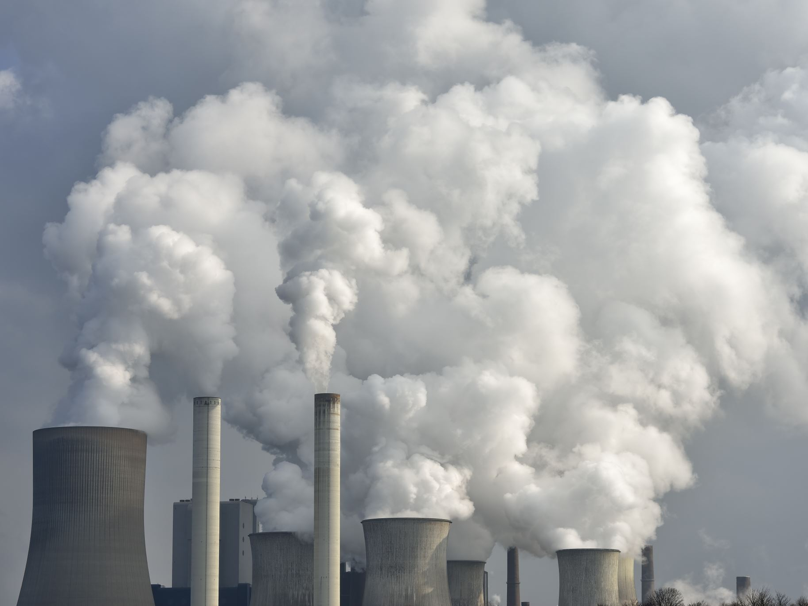
Challenges of Carbon Economy
By Prince Singh, Romi Yadav and Kuldeep Parmar

Slide 2
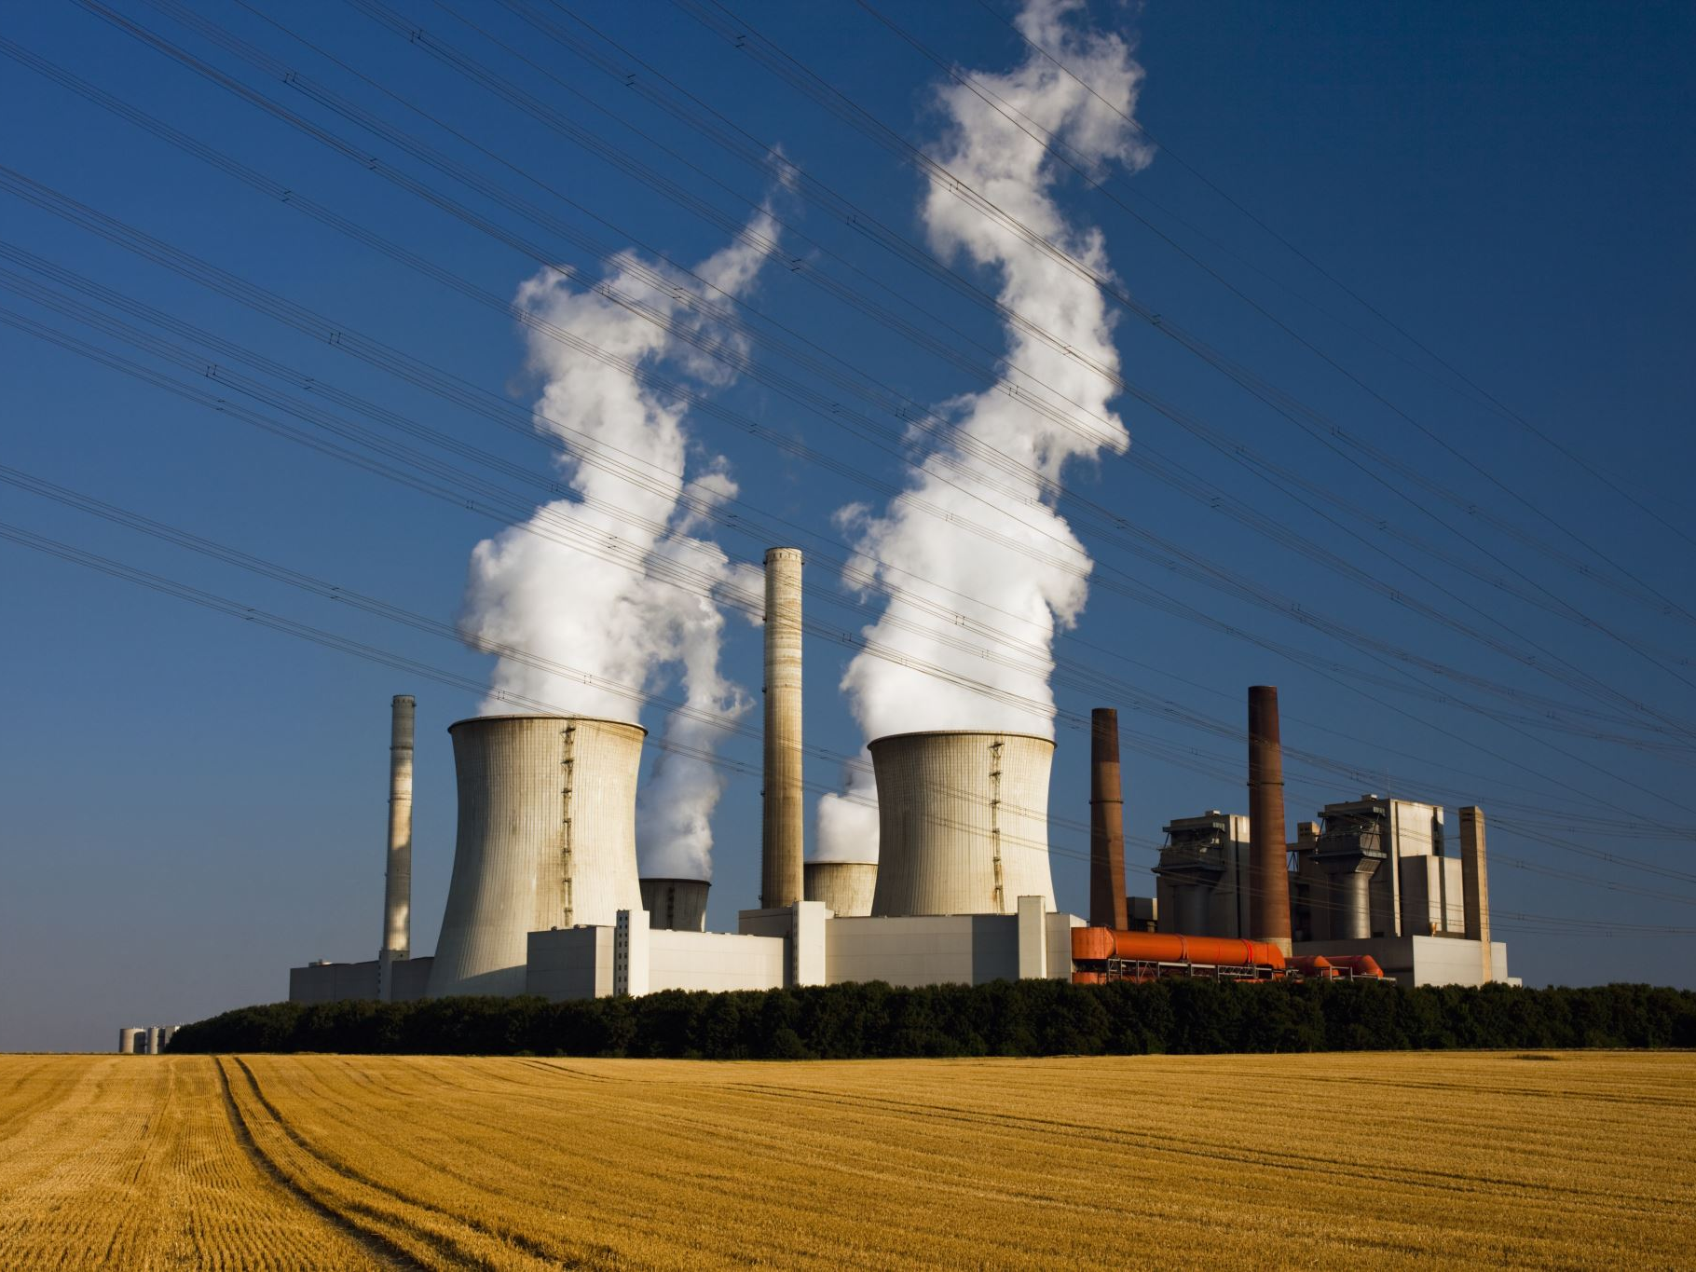
What is Carbon Economy?
A carbon economy revolves around rising energy prices, concerns about energy sustainability in the long run and the ensuring pressure from society to reduce GHG emissions related to fossil fuels.

Slide 3

Introduction to Carbon Economy
Some sections of the user groups are convinced of the effort. others are skeptics, and then there are some who may actively work against the effort.
Reasons for this variation in Green IT support could be that the terms Green IT and sustainability are themselves susceptible to varying interpretations. Added to that is the fact that the level of interest in sustainability by each individual varies depending on a combination of personal and professional goals of that stakeholder.
For example, a business analyst in the customer service department has different concern of sustainability than that of a manager in the data center. Former wants fast, fail-safe retrieval of information to ensure the business's financial viability. Yet the latter wants to reduce redundant systems to decrease power consumption for both the financial viability and the environmental responsibility of the business.
Both the analyst and the manager may be concerned about sustainability, but their views of what is necessary to sustain are different based on their own perspectives.

Slide 4
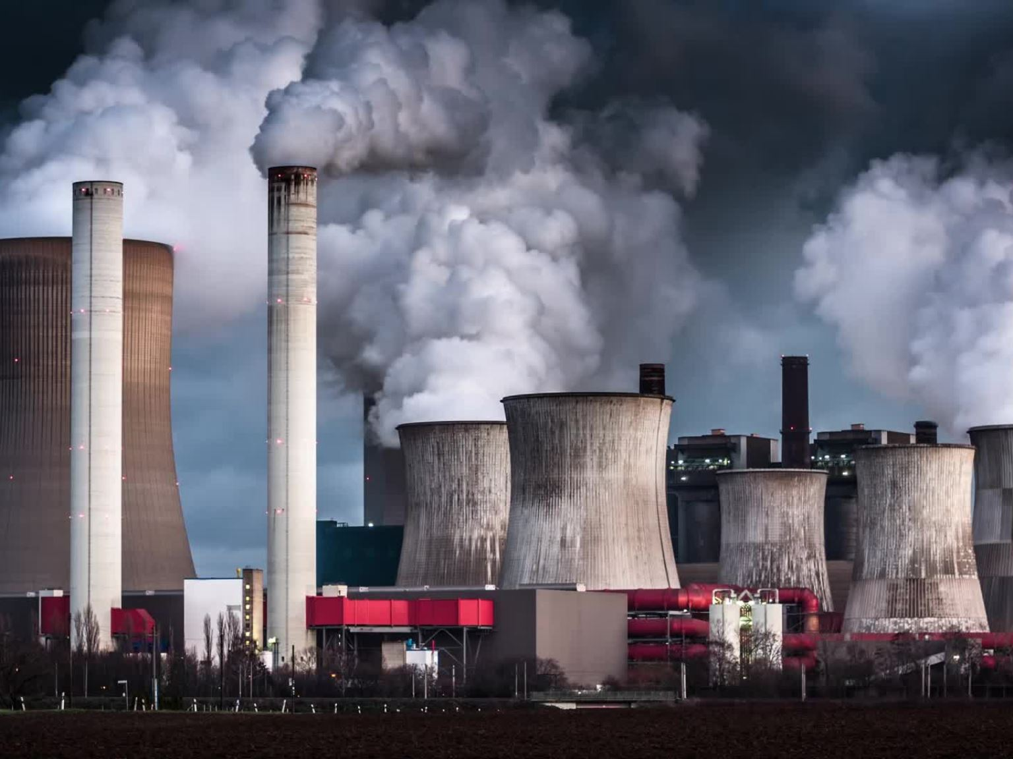
Challenges of Carbon Economy
Uncertainty in terms of rules and regulations that can be applied and adhered to with confidence.
Uncertainty in terms of the scopes of the emissions to be included in the calculations.
uncoordinated emergence of macroeconomic levers (such as carbon taxes and carbon trading) that are also not uniform across regions.
Disagreements amongst nations—especially divided amongst the developed versus developing economies—to ratify and implement.

Slide 5
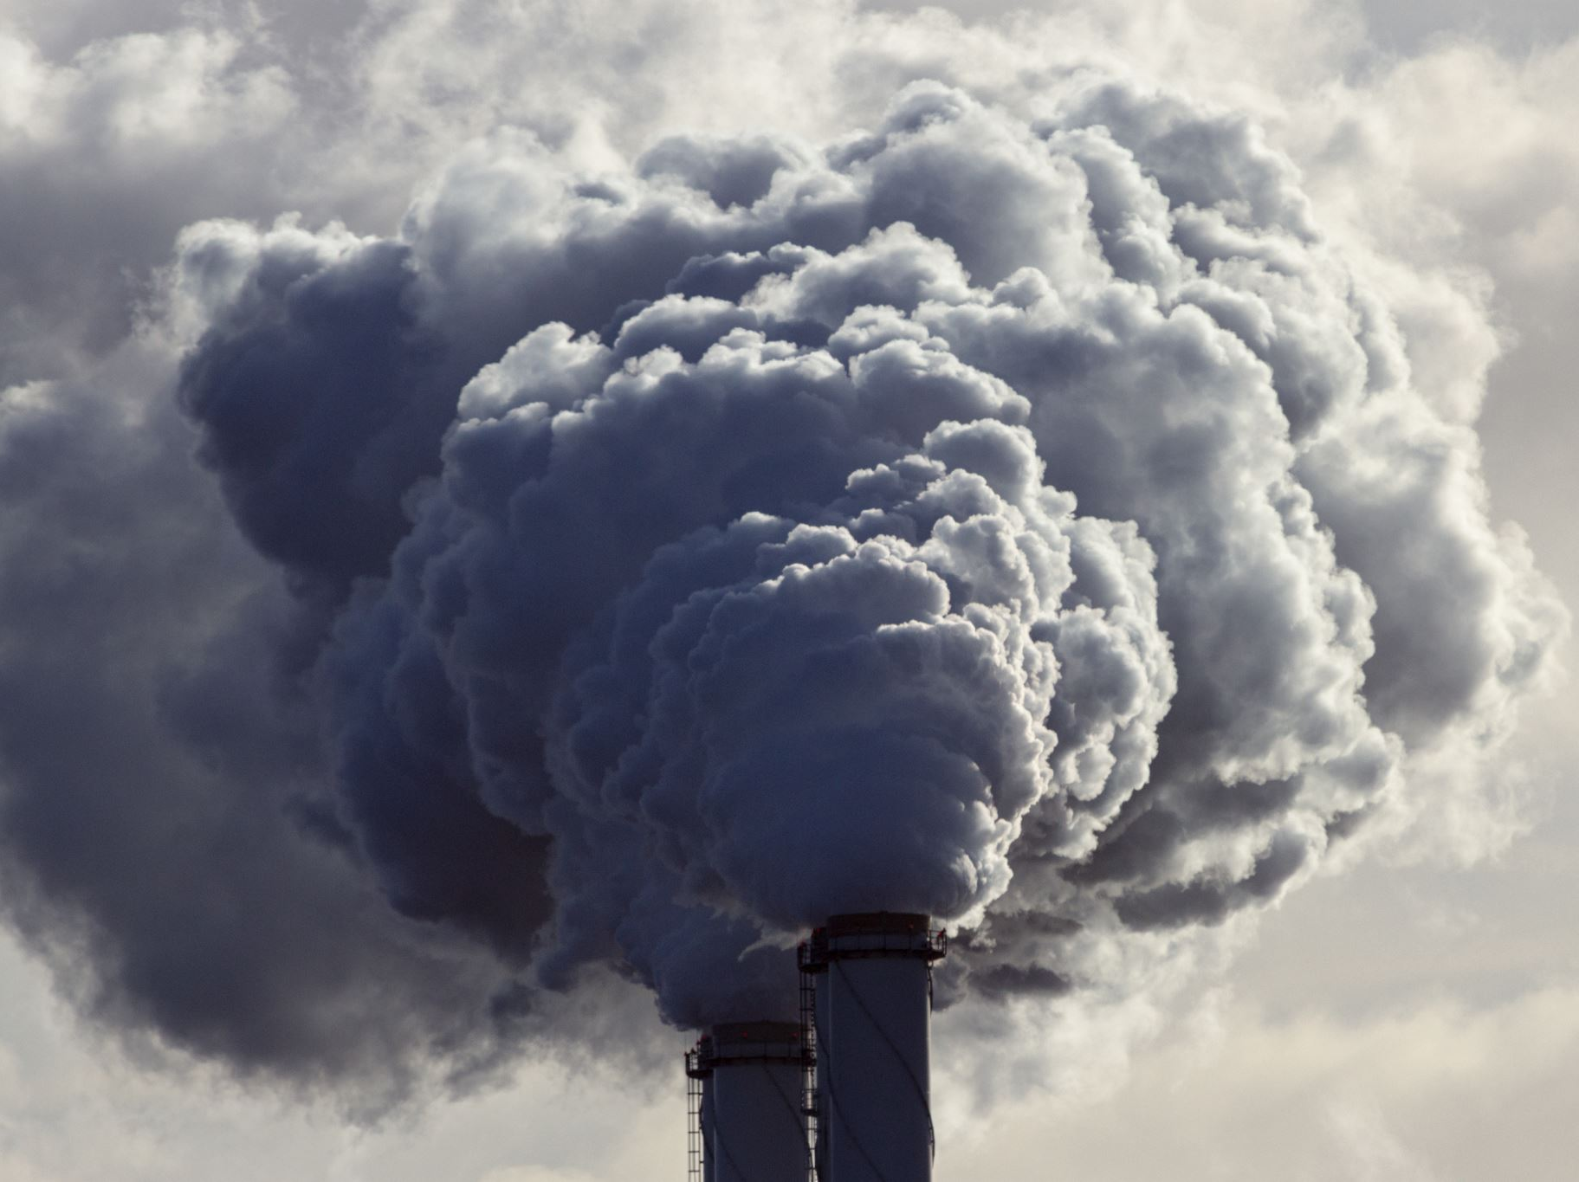
Challenges of Carbon Economy
Facilities like data centers cannot be replaced as quickly as the servers inside them due to high infrastructure costs—leading to a mismatch between the hardware and the facilities that house them.
Uncertainty in terms of trying out new products and services that may be eco-friendly as they may disturb the existing processes.
Overall shortage of consulting and in-house skills in the area of EI.

Slide 6

Challenges of Carbon Economy
Subjective nature of Green IT that depends on the context and also on the personal motivation of the individual.
Lack of availability of substantial “winning stories”.
Skepticism from various sections of an organization including, occasionally, some part of the leadership

Slide 7

Challenges of Carbon Economy
Lack of accountability on the part of staff for their own carbon emissions—perhaps due to lack of feedback.
Lack of overall industry experience in business transformation programs that are specifically aimed at Green IT.
Highly complex supply chain systems that include collaboration amongst multiple organizations— making it extremely challenging to implement environmental initiatives across the entire supply chain.
Operational requirements usually taking precedence over strategic approach to the environment.

Slide 8

Example of challenge in carbon economy
Carbon economies in the developing countries, are unlikely to respond to the carbon reduction challenge only through legislation or negotiations. In those direct enforcement by polluters an approach disdained by most economists, has been the most widely used method of pollution control.

Slide 9

How to tackle challenges of Carbon Economy
Challenge associated with the subjective nature of Green IT, which has to deal with both individual and collective attitude of the organisation, requires significant effort in education and training, internal promotion of the initiative, and creating and sustaining an ongoing atmosphere of environment responsibility.

Slide 10

Thank you

